Slide 1




An examination of the Cryptocurrency “Pump and Dump” Ecosystem
JT Hamrick, Farhang Rouhi, Arghya Mukherjee, Amir Feder,
Neil Gandal, Tyler Moore, Marie Vasek
October 2020

Slide 2
Long Term Research Project – Economists + CS
Economics of Digital Crime/Price Manipulation - Cryptocurrencies
JME Paper – Price manipulation of single agent led to rise in BTC in 2013
No longer a niche market – valuations reached $800 Billion in Dec 2017
Ecosystem with 2000 coins, many exchanges, digital wallets, etc.
This paper → pumps and dumps in cryptocurrencies
New social media technology (Discord, Telegram) 350 Million users
Low Cost to running pump and dump schemes
Little regulation
We look at the Jan – June 2018 period
We document more than 3000 such schemes during that period
Significant interest in cryptocurrency pump and dump schemes (Google Trends)
Notes:
- At a high level, here’s our key findings:
We came across nearly 5000 distinct pump signals affecting 248 coins over a period of 6 months.
That’s a lot of attempted manipulation. Over 10% of coins had at least one pump attempted on it during this time.
Pumps can be highly successful. For less popular coins the median 5-minute price increase was around 20%.
But even more popular coins could be affected. The median jump for top 75 coins was nearly 5%.
We conducted a series of regressions and found that coin popularity is inversely related to pump success, that more widely traded coins (as measured by the number of exchanges it can be traded on) are less successful, and the size of the pump signal audience is positively correlated with price rise.

Slide 3
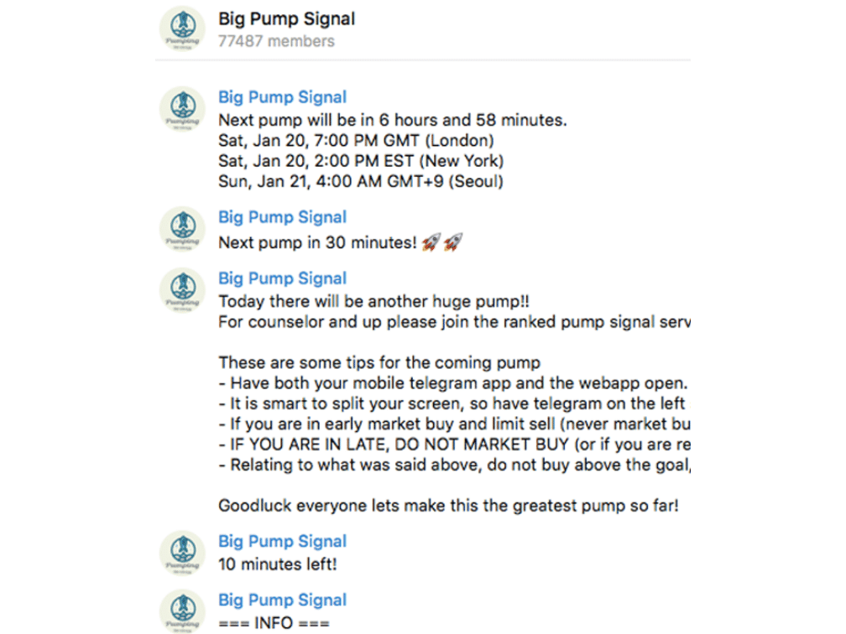
Notes:
- Here is an example of a pump and dump group on an instant messaging service called Telegram.
- The name of the channel is Big Pump Signal having close to 80k members, where pumps are being advertised and to encourage other members to join in to make profit.

Slide 4
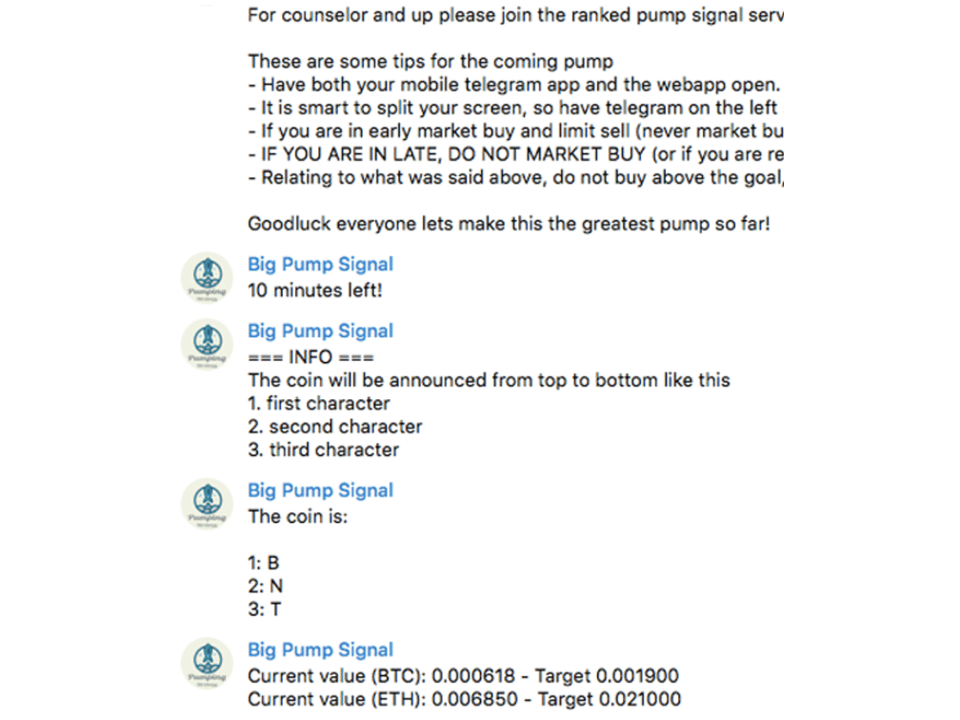
Notes:
- Obscure way of sending pump signals
- This particular signal also mentions the current price of the coin and the target they want to reach.

Slide 5
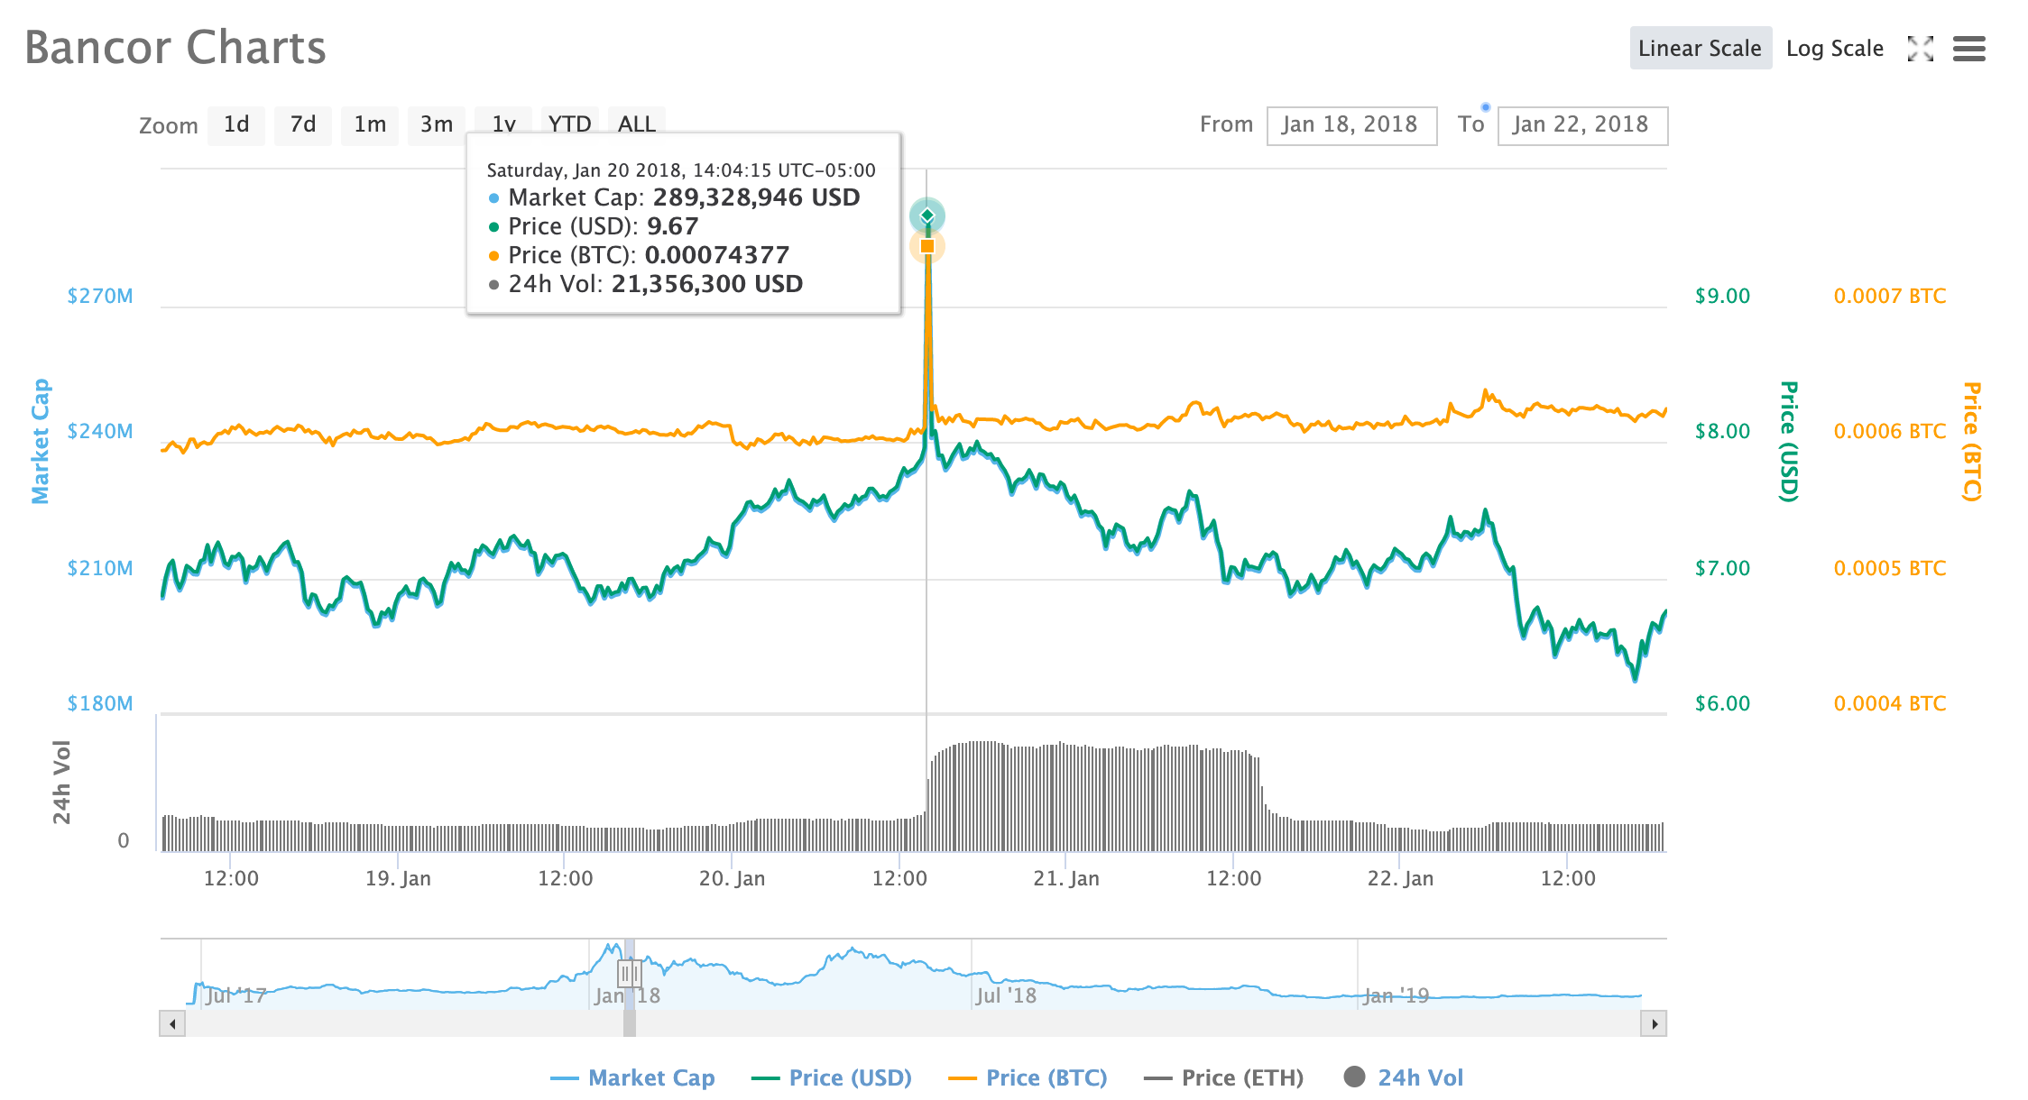
Notes:
- This is a screenshot from coinmarketcap.com of the particular coin around the same time and you can notice the sudden spike in price of the coin and the jump in volume.

Slide 6
Identifying pump signals: types
Transparent (countdown) (12% Telegram,11% Discord)
  Easy to identify as they use words “Pump” and “Dump”
  “Pump To The Moon”
Obscured (price signal) (88% Telegram,42% Discord)
  Avoid the words “Pump” and “Dump”
  Provide targets instead
  Most of these channels requires a membership fee
  “KEYBTC pumping, target 138”
Copied (40 % Discord)
  Copied pump signals from different sources
  “[2018-05-31 13:43:56]
Notes:
- In the course of identifying pump signals, we identified 3 broad groupings
- In a few cases (around 10% of the time), pumps were brazen.
- Most of the time, however, the channels hid their true nature, by avoiding terms such as pump. These channels were also often invitation only, and had premium membership options
- Around 40% of the discord signals were actually copied from other groups or telegram channels. This data is valuable for validation. We remove these duplicates during analysis.

Slide 7
A Bit of Theory
3.1 A Bit of Theory. . .
Economic theory suggests that the cryptocurrency “pump and dump” ecosystem would not succeed over time for the following reasons:
Pump and dump schemes need outside investors to succeed. Initial surge in volume attracts additional traders. Such (honest) traders in cryptocurrencies learn how to recognize pump and dumps and adjust their strategies accordingly.
Many insider members of the pump and dump schemes actually lose money. As has been documented, administrators/insiders of the schemes typically make purchases before the “beginning time of the pump. This would make it less attractive to participate over time.
Regulators might begin to react if the phenomenon becomes prolific. A few pump and dump schemes will not have an effect on regulatory policy, but hundreds or thousands of pumps might eventually lead regulators to act.
Notes:
- At a high level, here’s our key findings:
We came across nearly 5000 distinct pump signals affecting 248 coins over a period of 6 months.
That’s a lot of attempted manipulation. Over 10% of coins had at least one pump attempted on it during this time.
Pumps can be highly successful. For less popular coins the median 5-minute price increase was around 20%.
But even more popular coins could be affected. The median jump for top 75 coins was nearly 5%.
We conducted a series of regressions and found that coin popularity is inversely related to pump success, that more widely traded coins (as measured by the number of exchanges it can be traded on) are less successful, and the size of the pump signal audience is positively correlated with price rise.

Slide 8
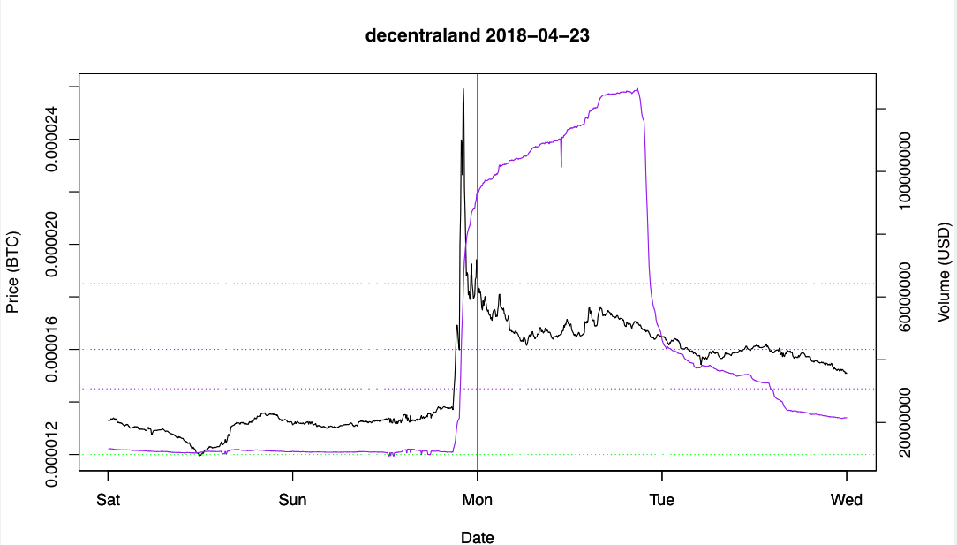
Example: pump before signal:
Insiders buy early
(Black line is the price)
Notes:
This one is another example of a pump where the actual pump trails the pump signal time. Given these shifts, we found that the maximum 5-minute price reliably identified the point at which the trading volume shot up from pump activity.

Slide 9
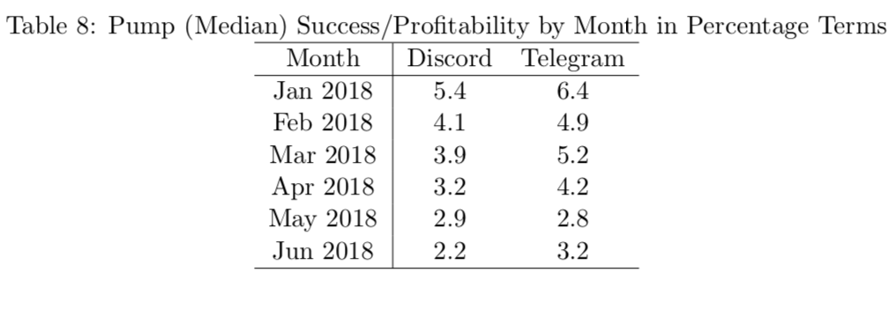
Key Finding 1: Overall Median Success/Profitability by Month (in %) declines steeply over time
Key Finding 2: When Examining Two Types of Pumps Separately:
“Countdown/Transparent” Pumps: No Change in Profitability over time
“Obscured/Price Target” Pumps: Steep Decline in Profitability over time
Notes:
The volatility of the coin is indeed associated with a higher percentage price increase from the pump.
Controlling for volatility, we find that our results are qualitatively unchanged.

Slide 10
Key Findings: Concentration in the Ecosystem
Cryptocurrency Exchanges: From our data, Binance and Bittrex were by far the most popular exchanges for pump and dump schemes. Binance and Bitfinex together accounted for 86% (87%) of the pumps for pumps that listed/recommended an exchange on Telegram (Discord).
Binance was the largest cryptocurrency exchange, by trading volume, and Bittrex had large trading volume as well. Both exchanges offer trading in hundreds of cryptocurrencies, which likely made them attractive to organizers of the pump and dumps.
Channels: The perceived wisdom was that there were many channels running pumps. Three channels accounted for roughly 45 percent of all the pumps on Telegram during the period we analyze.
Coins: twenty or so coins accounted for 20% of all pumps
Notes:
- At a high level, here’s our key findings:
We came across nearly 5000 distinct pump signals affecting 248 coins over a period of 6 months.
That’s a lot of attempted manipulation. Over 10% of coins had at least one pump attempted on it during this time.
Pumps can be highly successful. For less popular coins the median 5-minute price increase was around 20%.
But even more popular coins could be affected. The median jump for top 75 coins was nearly 5%.
We conducted a series of regressions and found that coin popularity is inversely related to pump success, that more widely traded coins (as measured by the number of exchanges it can be traded on) are less successful, and the size of the pump signal audience is positively correlated with price rise.

Slide 11
Other Key findings
Pump and dump is pervasive: observed more than 3000 pump and dump attempts on 248 currencies over 6 month period in 2018
Pump and dumps rewards
  Less popular coins (Below 500 rank): 19-23% median 5-min price jump
  More popular coins (Top 75 coins): 3.5-4.8% median 5-min price jump
Regressions demonstrate that pumps experience higher price jumps if:
  Coin is less popular
  Coin is traded on fewer exchange
  Controlling for other factors, profitability over time declined significantly during the period
Notes:
- At a high level, here’s our key findings:
We came across nearly 5000 distinct pump signals affecting 248 coins over a period of 6 months.
That’s a lot of attempted manipulation. Over 10% of coins had at least one pump attempted on it during this time.
Pumps can be highly successful. For less popular coins the median 5-minute price increase was around 20%.
But even more popular coins could be affected. The median jump for top 75 coins was nearly 5%.
We conducted a series of regressions and found that coin popularity is inversely related to pump success, that more widely traded coins (as measured by the number of exchanges it can be traded on) are less successful, and the size of the pump signal audience is positively correlated with price rise.

Slide 12
Outline
Data collection methodology
Descriptive results
Analytical results
Notes:
Here is an outline of the rest of my talk.

Slide 13
Outline
Data collection methodology
Descriptive results
Analytical results
Notes:
First we’ll talk about the data collection methodology.

Slide 14
Data collection methodology
Identifying pump signals
  Advertised pumps from Telegram channels and Discord groups
Collecting coin pricing data
  5-minute granularity from CoinMarketCap.com
Identifying pump timing
Notes:
The first step of data collection was focused on identifying p&d signals from Telegram and Discord channels.
We then inspected pricing data for affected coins.
Finally, we devised a method to pinpoint the timing of pump signals distinct from when it was reported on the platforms.
Now, I’ll talk about each of these steps in turn.

Slide 15
Identifying pump signals: methodology
Goal: comprehensively and reliably identify as many pump signals as possible
Approach: seek out groups from public sources
  Master thread on bitcointalk.org listing all known Discord groups with more than 100K members
  Android app for tracking P&D group popularity – we track any group (Discord) or channel (Telegram) with at least 4K members
  Joined all channels (often by invitation) and parsed data to extract pumps using keywords selected for that channel
  Snowball approach: found new channels mentioned and joined
  Manually verified all pump signals
Notes:
Our objective was to identify as many pump signals as we can and ensure that they are distinct attempts at pumping coins.
We started on bitcointalk where there is a thread on all known discord group with more than 100k members
We complemented this by using an android app that tracks P&D group and we joined these channels often by invitation
While doing so, we found more channels within the the channels that we were tracking and found more channels
To extract the pump we identified specific keywords for these channels, because each used their own jargon for promotion.
Each keyword match was then manually verified to be a pump with duplicates removed.

Slide 16
Identifying pump signals: results
Observed 3,417 distinct pump signals on 248 currencies over between January and June 2018
  We found 2,469 unique Telegram signals on 30 channels
  We found 952 unique Discord signals
Notes:
This resulted in around 4.8k pump signals observed in between the time frame of January of July of 2018
Over three quarters of the total signals were found in Telegram and the rest is from Discord groups

Slide 17
Collecting coin pricing data: CoinMarketCap
Leading website of aggregated data on cryptocurrencies
~ 2000 currencies
~ 200 exchanges
5 minute interval price (in BTC and USD)
5-minute interval 24-hour trailing volume
316 million data points
Notes:
- As you may know, CMC is the top aggregator of reported coin trading data.
- Over 2000 coins self-reported by around 200 exchanges
- We collect pricing data at 5-minute granularity
- We also collect rolling 24-hour volume at the same granularity.

Slide 18
Identifying pump timing
Pump signals are an indicator and signals do not always match with the time of the pump
We define pump timing as when the biggest 5-minute increase in price occurs over a 48 hour window before and after pump signal
Notes:
- Pump signals do not always match with the time of the actual pump. This can be for many reasons, such as when premium channels are notified before free ones.
- So we use the pump signal time as a starting point to find the actual pump times.
- We define pump timing as the biggest 5 minute increase in price that takes place over a 48 hour window before and after the pump signal time.

Slide 19
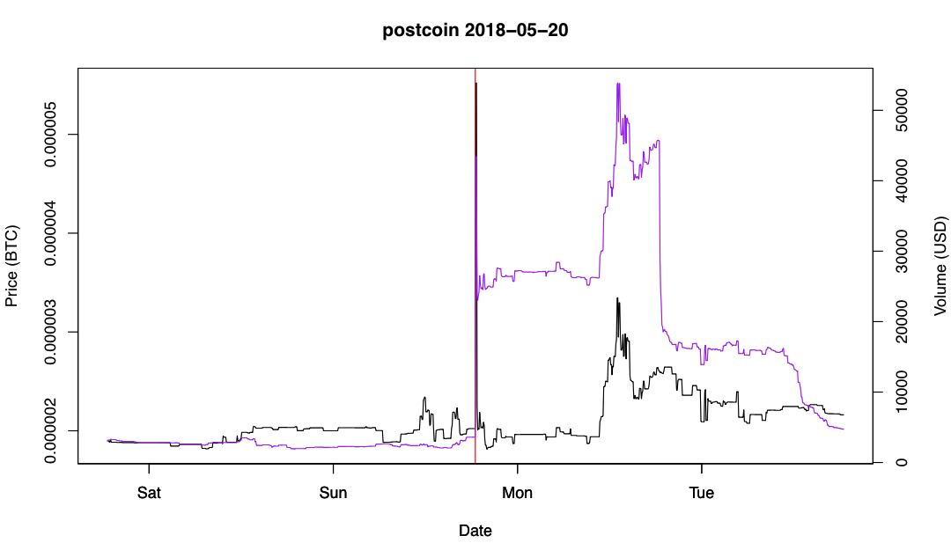
Identifying pump timing: signal coincides with pump
(Black line is the price)
Notes:
This is an example of a pump that coincides exactly with the pump signal time. The black line is the price, the purple indicates 24-hour trading volume, and the red line (hard to see) is the reported pump signal time.

Slide 20
Example: pump before signal: Insiders buy early
(Black line is price; red line is the scheduled time)
Notes:
This one is another example of a pump where the actual pump trails the pump signal time. Given these shifts, we found that the maximum 5-minute price reliably identified the point at which the trading volume shot up from pump activity.

Slide 21
Outline
Data collection methodology
Descriptive results
Analytical results
Notes:
Now let’s talk about some of our findings.

Slide 22
Variables of interest
Dependent Variable
  Percentage Increase in BTC price
Independent Variable
  # Exchanges (Exchanges in which a coin is traded)
  Rank (Bitcoin being ranked 1)
  # Pairs (Number of currencies a coin is traded on (e.g. BTC/ETH)
  # Server Members (Number of members in a Discord server)
  # Views (Telegram)
  Time, i.e., month
  Major exchange (Binance, Bittrex)
Notes:
For the purpose of analysis of pump success, we use Percentage increase in BTC prices as a dependent variable as not all coins are traded in USD
Number of exchanges where a coin is being traded is used as a dependent variable followed by ranks of the coin (bitcoin being 1) as the ranks are based on market capital. Number of coin pair (BTC/ETH) being one of them.
For discord channels, we also collected the number of members in a channel which we use as an independent variable

Slide 23
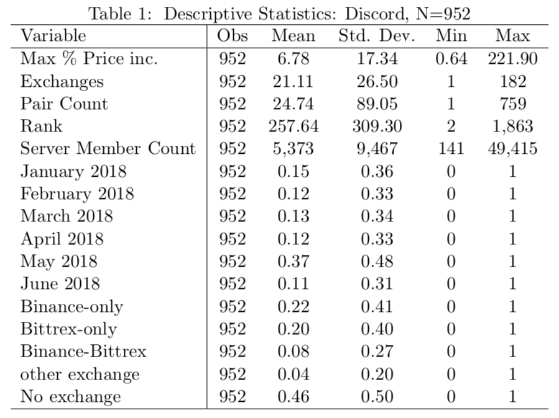
Summary statistics: Discord
Notes:
- The summary statistics of discord pump signals shows an average increase of percentage price of a pumped coin of around 7 % where the maximum price increase following by a pump signal being more than 200 %

Slide 24
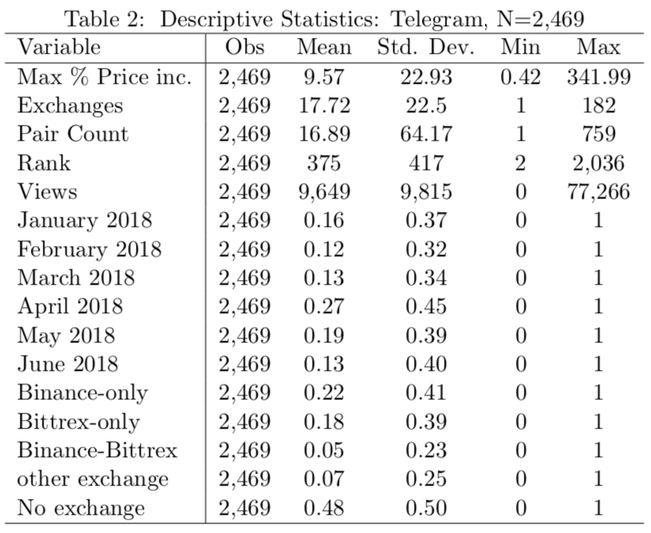
Summary statistics: Telegram
Notes:
Similarly for the pump signals from telegram channels, we found that on an average there is an average percentage price increase of a pumped coin by 10% where as the maximum price increase was more than 300 %

Slide 25
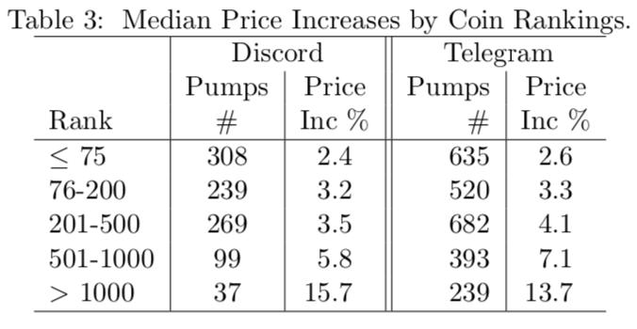
Price rise greater for less popular coins
Notes:
We noticed that there both lower and higher ranked coins were pumped
however, the coins ranked lower ranked coins experienced a higher price increase compared to higher ranked coins.
For higher ranked coins, the median price increase for higher ranked coin for discord and telegram ranged between 3-5% where as for lower ranked coin the price increase was 18-24%

Slide 26
Explaining Success in Increasing Price
Dependent Variable
  ln(Percentage Increase in BTC price)
Independent Variable
  ln(# Exchanges) (Exchanges in which a coin is traded)
  Rank (Bitcoin being ranked 1)
  ln(# Pairs) (Number of currencies a coin is traded on (e.g. BTC/ETH)
  ln(# Server Members) (Number of members in a Discord server)
  In (# Views of Pump Signal) (Telegram)
  Time (Months)
  Exchanges (Binance, Bittrex)
Notes:
- For the purpose of running regressions we used a logarithmic scale for all the variables except Ranks as the data was skewed.

Slide 27
Outline
Data collection methodology
Descriptive results
Analytical results
Notes:
Now I will go through the regression analysis to measure pump success.

Slide 28
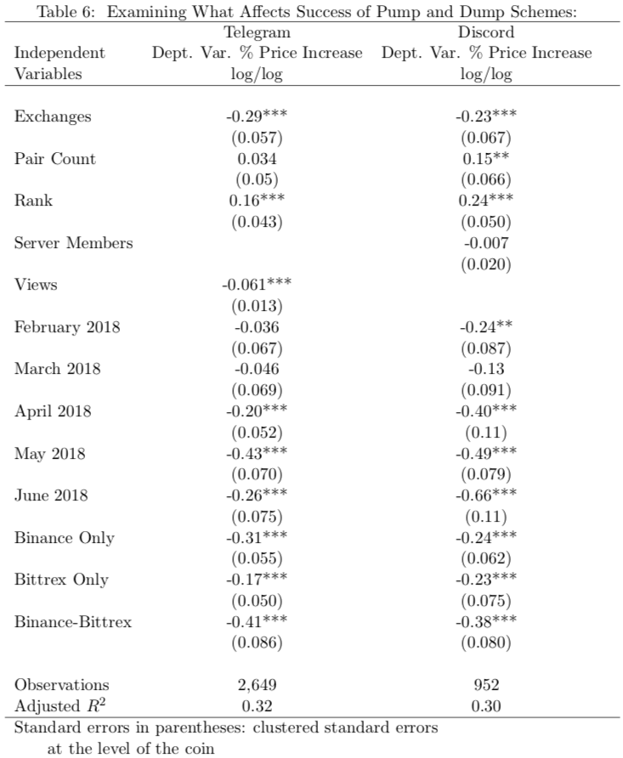
Explaining Success: Both Type of Pumps Together
More exchanges associated with lower % price increase from pump
Higher rank associated with higher % price increase from the pump
Success of the pump falls over time
Less success on dominant exchanges

Slide 29
Two Pump Types Separately: Telegram Only
271 Transparent (countdown), 2198 Obscured (price target) Pumps
The transparent pump and dumps typically did not pump the same coin often. Obscured pumps often pumped the same coins many times.
Transparent pump and dump schemes achieved a 7.7% median rate of return, while the obscured pumps achieved a 4.1% median return.
The returns earned by transparent pumps did not decline at all over time, while those earned by obscured pumps declined significantly over time.
Variable “Views” is positively associated with success and the effect is statistically significant for sophisticated traders. This variable is negatively associated with success and the effect is statistically significant for unsophisticated traders .
Notes:
- For the purpose of running regressions we used a logarithmic scale for all the variables except Ranks as the data was skewed.

Slide 30
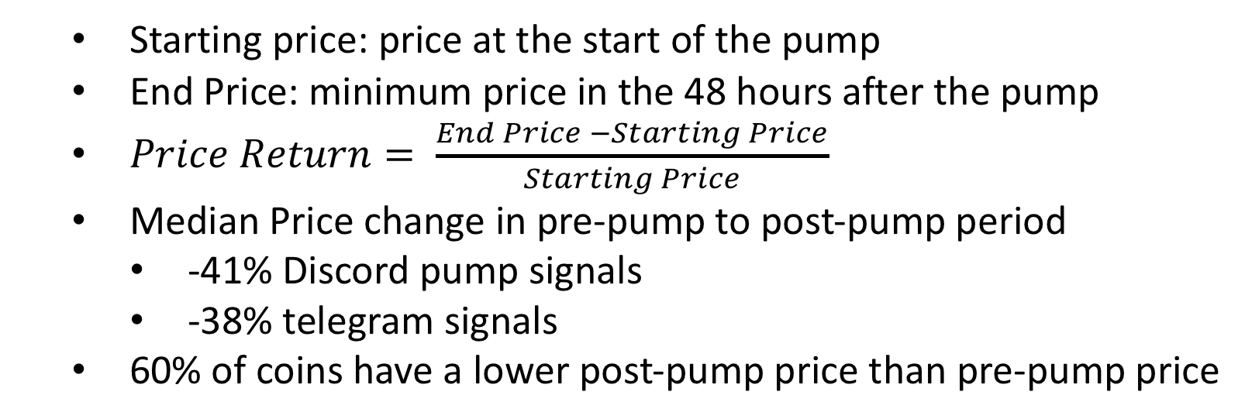
What happens after pump is over?
  Starting price: price at the start of the pump
  End Price: minimum price in the 48 hours after the pump
  $Price Return= \frac{End Price −Starting Price}{Starting Price}$
  Median Price change in pre-pump to post-pump period
    -41% Discord pump signals
    -38% telegram signals
  60% of coins have a lower post-pump price than pre-pump price
Notes:
We used Price return as a measure to see what happens when a pump is over.
Median price change after a pump is over for telegram and discord signal is negative 41 and negative 38 person respectively

Slide 31
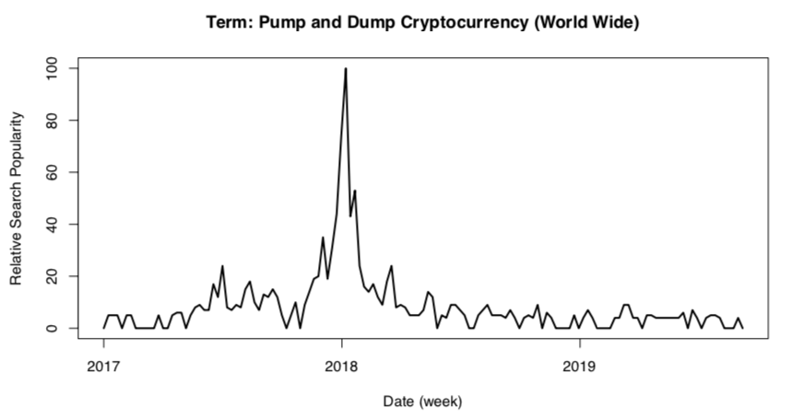
Figure 1: Google Trends results from searching for “pump and dump cryptocurrency”

Slide 32
Concluding remarks – Thoughts on Regulation
Explosion of cryptocurrencies has created conditions for pump and dump ecosystem
Regulators could perhaps significantly disrupt future pump and dump schemes by focusing their efforts on the most prolific exchanges and pump channels. Far from insurmountable, a concentrated ecosystem makes enforcement tractable.
In February 2018, CFTC issues warning against and bounty on Cryptocurrencies. Interest in the CFTC shoots up to a Google trends high
Interest in pump-and-dumps peaked shortly before interest in the CFTC. Perhaps, more regulatory action at this stage might have dampened the phenomenon.
Federal regulators should be very concerned by the presence of the pump and dump ecosystem. Even though we have demonstrated a decline in pump profitability, the scope of the phenomenon should raise red flags and trigger countermeasures.
Notes:
Reading the slide

